Slide 1
Determinants of Equilibrium output and IS_LM Model

Slide 2


The multiplier effect
By how much does a 1 rupee increase in autonomous spending raise the equilibrium level of income?
Additional spending cause an increase in income by ‘c’ times

Slide 3
Round | Initial Injection | Production Changes | Consumption | Saving
1 2 3 4 5 6 -- -- -- | ₹ 1000 | ₹ 1000 750 563 422 316 237 3288 | ₹ 750 563 422 316 237 178 2466 | ₹ 250 187 141 105 79 59 822

Slide 4
The multiplier effect
AD = Y
E
Aggregate demand
AD₀
45⁰
0
Y
ΔY
Y₀
Income, Output

Slide 5
What would be the limit of new employment created if the government undertook to stimulate employment growth by spending for public works projects?
Chain of causation
Expenditure for public works
Increase in employment in construction, trades, and building supplies industries
Increase in income of people employed in these industries
Increase in spending for consumption goods → increase in employment in consumption goods industries.

Slide 6



The Multiplier Effect

Slide 7
The government Sector
AD = C+ I+ G 2.1
Government intervention affects in two ways
Through government purchases
Through taxes and transfers
C= f( Yd) 2.2
Yd = (Y+TR-TA) 2.3
2.4
C
=
C
+
cYd
C
=
C
+
c(Y+TR-TA)

Slide 8
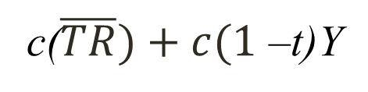
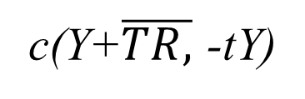

Specification of fiscal policy ( level of G purchases, level of transfers and tax structures)
We assume govt. purchases a constant amount
G= $\overline{G}, TR= \overline{TR,}$ TA= tY
2.5
2.6
C
=
C
+
c(Y+$\overline{TR,}$ -tY)
C
=
C
+
c($\overline{TR})+c(1$ –t)Y

Slide 9

AD= $\overline{C}$+$\overline{I}+\overline{G}+\overline{cTR}+c\left(1−t\right)Y 2.7$
AD= $\overline{A}+c\left(1−t\right)Y$

Slide 10
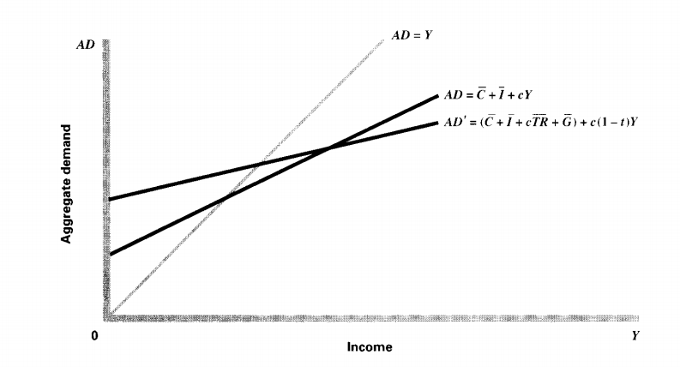

Slide 11
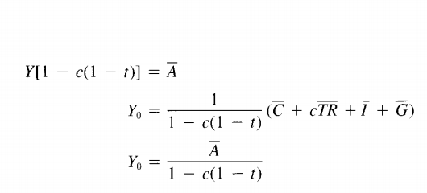
For equilibrium level of income

